Slide 1

Mawlana Bhashani Science and Technology University Department of Information and Communication Technology Santosh ,Tangail-1902.
A Presentation On
“Extreme Programming: A Lightweight Approach to Software Development”
Agile Methodology for Rapid Delivery and High Quality
For The Course
“ Software Engineering ”
Course Code: ICT-3209
Submitted to:
Dr. Ziaur Rahman
Assistant Professor
Dept. of ICT
Mawlana Bhashani Science and Technology University
Submitted by:
Name: Shetu Saha
ID: IT-21009
3rd Year, 2nd Semester
MBSTU ,ICT
Date Of Submission : 17 November,2024

Slide 2
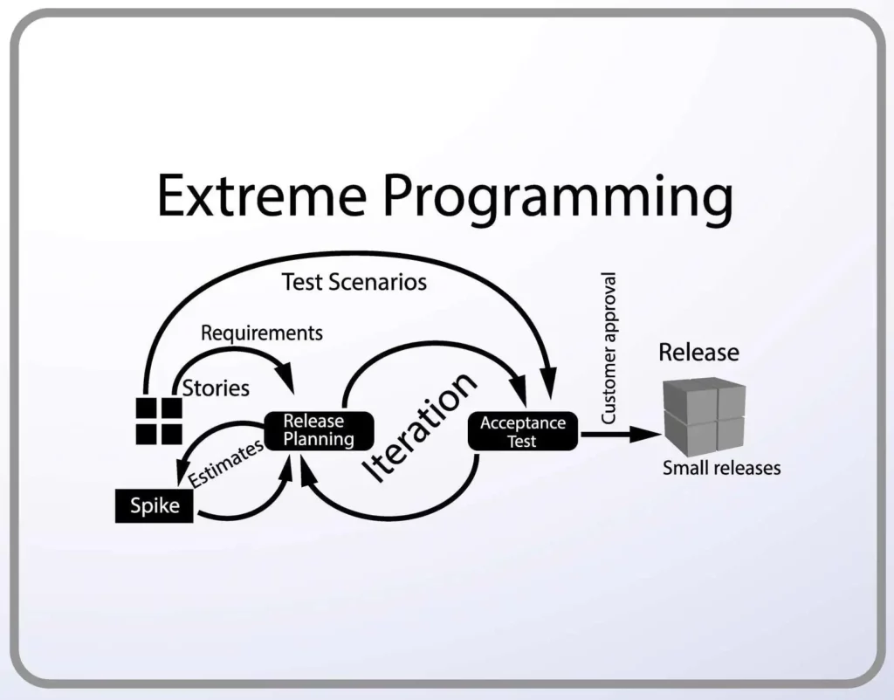
What is Extreme Programming?
Extreme Programming (XP) is an Agile Software Development methodology that focuses on delivering high-quality software through frequent and continuous feedback, collaboration, and adaptation. XP emphasizes a close working relationship between the development team, the customer, and stakeholders, with an emphasis on rapid, iterative development and deployment.

Slide 3
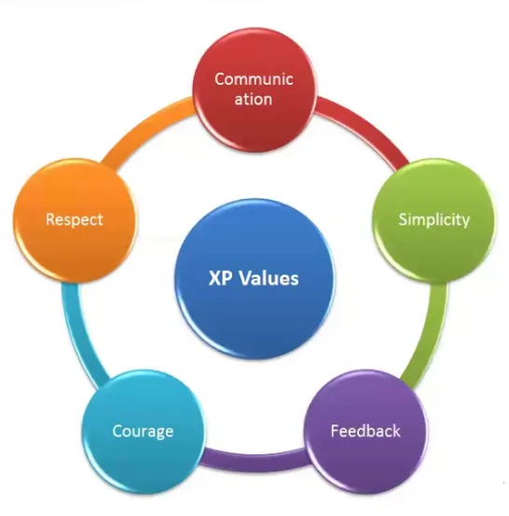
Core Values of XP
1.Communication
2.Simplicity
3.Feedback
4.Courage
5.Respect

Slide 4
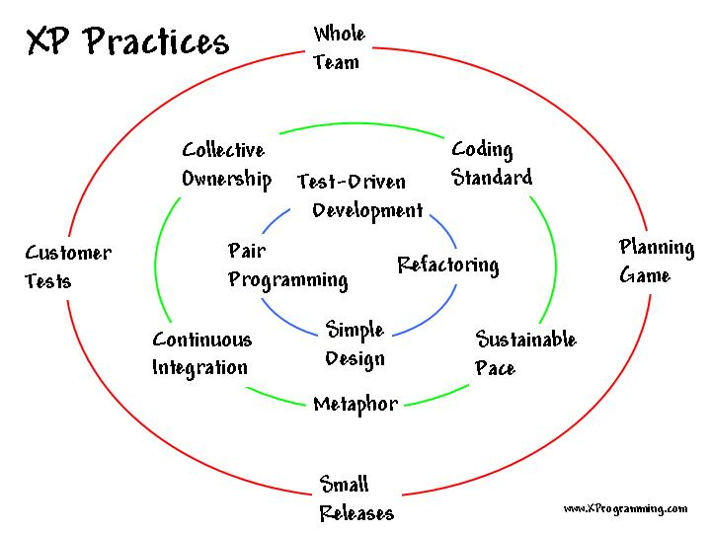
Core Practices of XP
Pair Programming: Two developers work together on the same code at the same time.
Test-Driven Development (TDD): Write tests before writing code.
Continuous Integration: Integrate code frequently to catch errors early.
Refactoring: Continuously improve code quality without changing functionality.
Simple Design: Keep the design as simple as possible.
Small Releases: Deliver working software frequently.
Customer Involvement: Close collaboration with the customer.
Collective Ownership: All team members are responsible for the entire codebase.
40-Hour Week: Avoid burnout by limiting work hours.
Coding Standards: Adhere to consistent coding standards.

Slide 5
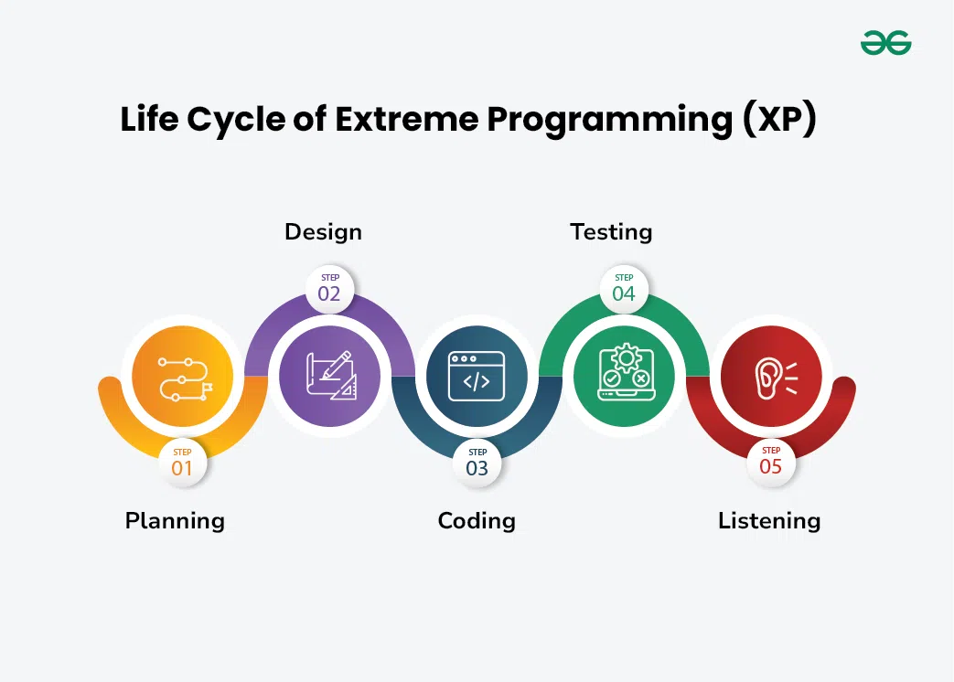
Life cycle of XP
1.Exploration Phase: Gather and prioritize user stories.
2.Planning Phase: Create iteration plans and break down tasks.
3.Iteration Phase: Develop and test small increments.
4.Release Phase: Deliver functional software and gather feedback.
5.Maintenance Phase: Address defects and adapt to changes.
6.Death Phase: Conclude the project when goals are met.

Slide 6
Advantages of Extreme Programming
Higher Quality Software:
Early detection of defects
Improved code quality and maintainability
Faster Time to Market:
Rapid development cycles
Continuous delivery of working software
Increased Customer Satisfaction:
Active customer involvement
Frequent delivery of value
Improved Team Morale:
Collaborative work environment
Reduced stress and burnout

Slide 7
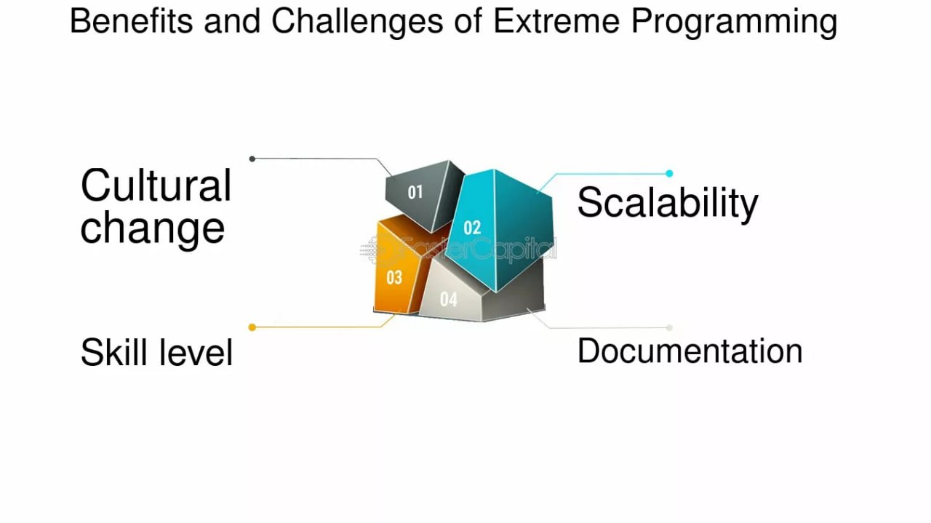
Challenges of Extreme Programming
Requires Strong Team Culture:
Trust, respect, and open communication are essential.
Customer Involvement:
Requires dedicated customer participation.
Skill Requirements:
Developers need strong technical skills and a willingness to learn.
Overhead of Practices:
Pair programming, test-driven development, and continuous integration can be time-consuming.

Slide 8
When to Use Extreme Programming
Small to Medium-Sized Projects:
XP is well-suited for projects with rapidly changing requirements.
Projects with Highly Skilled Teams:
The team must be experienced and committed to XP principles.
Projects with a Strong Customer Relationship:
The customer should be willing to be actively involved in the development process.

Slide 9
Case Study: A Successful XP Implementation
Company: [Name of Company]
Project: [Name of Project]
Challenges:
Tight deadlines
Frequent changes in requirements
Distributed team
XP Practices Implemented:
Pair programming
Test-driven development
Continuous integration
Frequent releases
Results:
Significant reduction in defects
Faster time to market
Increased customer satisfaction
Improved team morale and collaboration

Slide 10
Disadvantages of Extreme Programming (XP)
While XP offers many benefits, it's important to be aware of its potential drawbacks:
1. High Level of Commitment
2. Technical Skill Requirements
3. Risk of Technical Debt
4. Lack of Documentation
5. Not Suitable for All Projects
6. Potential for Overreliance on Pair Programming
7. Risk of Scope Creep

Slide 11
Conclusion
Extreme Programming is a powerful methodology for delivering high-quality software quickly.
By embracing its core principles and practices, teams can achieve significant improvements in productivity and software quality.
Consider the challenges and choose the right projects for XP
Learn from successful case studies to maximize the benefits of XP.

Slide 12
THANKS

